Slide 1

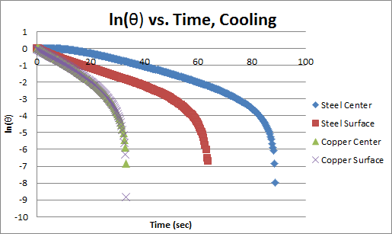
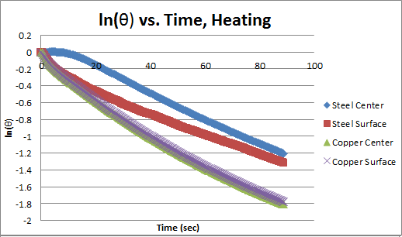
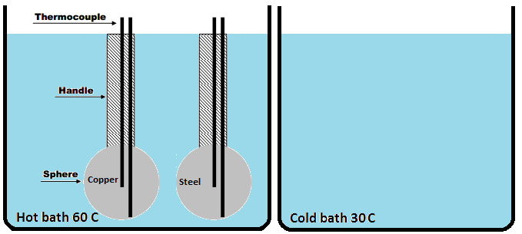


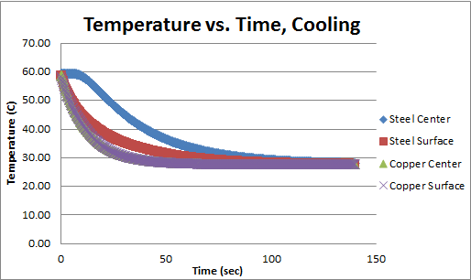
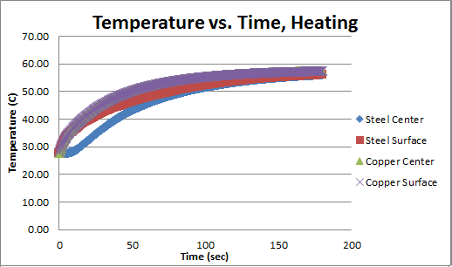
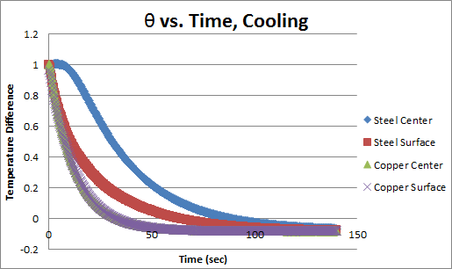
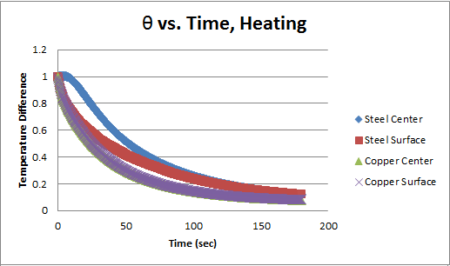

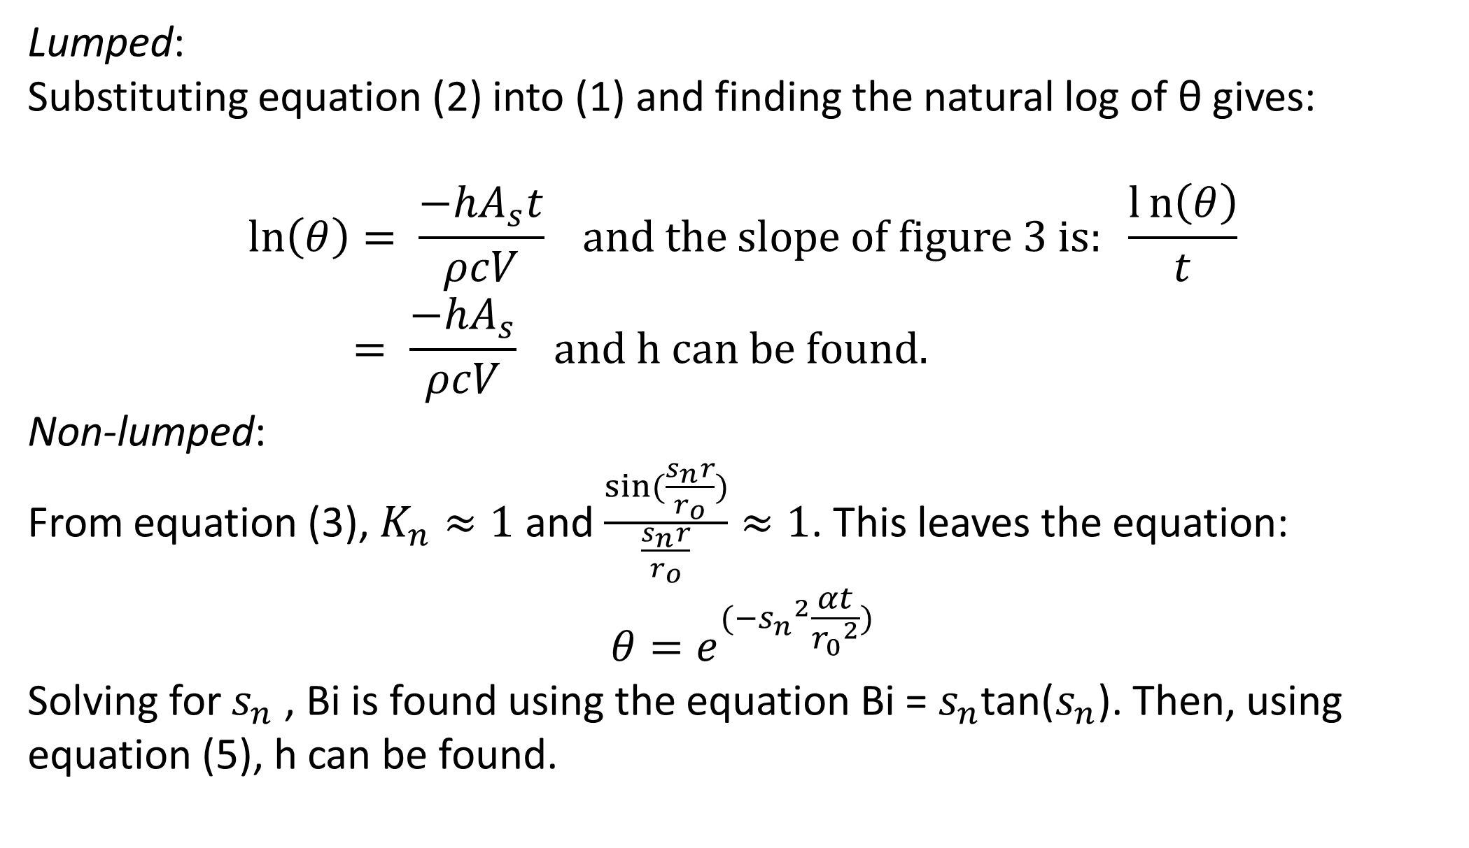
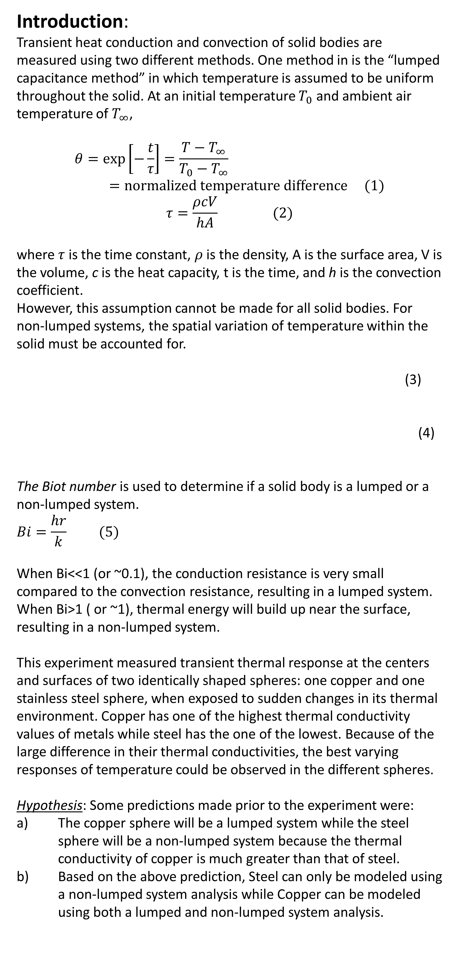
Transient Heat Conduction and Convection
of Copper and Stainless Steel Spheres
Boston University: Department of Mechanical Engineering
By Michelle Lee
Introduction:
Transient heat conduction and convection of solid bodies are measured using two different methods. One method in is the “lumped capacitance method” in which temperature is assumed to be uniform throughout the solid. At an initial temperature $T_{0}$ and ambient air temperature of $T_{∞}$,
$$θ=\exp\left[−\frac{t}{τ}\right]=\frac{T−T_{∞}}{T_{0}−T_{∞}}=normalized temperature difference (1)$$
$$τ=\frac{ρcV}{hA} (2)$$
where $τ$ is the time constant, $ρ$ is the density, A is the surface area, V is the volume, c is the heat capacity, t is the time, and h is the convection coefficient.
However, this assumption cannot be made for all solid bodies. For non-lumped systems, the spatial variation of temperature within the solid must be accounted for.
(3)
(4)
The Biot number is used to determine if a solid body is a lumped or a non-lumped system.
$$Bi=\frac{hr}{k} (5)$$
When Bi<<1 (or ~0.1), the conduction resistance is very small compared to the convection resistance, resulting in a lumped system. When Bi>1 ( or ~1), thermal energy will build up near the surface, resulting in a non-lumped system.
This experiment measured transient thermal response at the centers and surfaces of two identically shaped spheres: one copper and one stainless steel sphere, when exposed to sudden changes in its thermal environment. Copper has one of the highest thermal conductivity values of metals while steel has the one of the lowest. Because of the large difference in their thermal conductivities, the best varying responses of temperature could be observed in the different spheres.
Hypothesis: Some predictions made prior to the experiment were:
The copper sphere will be a lumped system while the steel sphere will be a non-lumped system because the thermal conductivity of copper is much greater than that of steel.
Based on the above prediction, Steel can only be modeled using a non-lumped system analysis while Copper can be modeled using both a lumped and non-lumped system analysis.
Methods:
Temperatures of the spheres were measured and recorded on a computer from thermocouples equipped on the spheres using a signal conditioning system, a data acquisition system, and National Instruments LabView software. Each sphere had a thermocouple at the center and surface to measure the temperatures at the centers and surfaces simultaneously.
Figure 3: In the graph for cooling, the ln(θ) values end at different times because some temperature difference values were negative due to the temperature of the spheres becoming lower than the ambient temperature of 30 ͦC. As seen in the previous figures, the curve for steel center continued to lag behind steel surface while the curves of copper center and surface overlapped.
Hypothesis a) : Based on the plots in figure one, the hypothesis shown to be true. The temperature curves of the center and surface of copper show that the temperature is uniform within the solid, resulting in a lumped system. The steel sphere however is a non-lumped system because the temperatures at the surface and center are not uniform.
Hypothesis b) : the plots in figures 2 and 3 are used to determine the heat convection (h) values for each case using lumped and non-lumped methods.
The copper and stainless steel spheres originally resting in a hot bath were moved to the cold bath and the temperature changes at the centers and surfaces of the spheres were measured until they reached steady states. Next, the spheres were moved back into the hot bath and the time was zeroed as soon as the spheres entered the cold bath. The temperatures were measured until they reached steady states.
Lumped:
Substituting equation (2) into (1) and finding the natural log of θ gives:
$$\ln\left(θ\right)= \frac{−hA_{s}t}{ρcV} and the slope of figure 3 is: \frac{l{n\left(θ\right)}}{t}= \frac{−hA_{s}}{ρcV} and h can be found.$$
Non-lumped:
From equation (3), $K_{n}≈1$ and $\frac{sin⁡(\frac{s_{n}r}{r_{o}})}{\frac{s_{n}r}{r_{o}}}≈1$. This leaves the equation:
$$θ=e^{(−{s_{n}}^{2}\frac{αt}{{r_{0}}^{2}})}$$
Solving for $s_{n}$, Bi is found using the equation Bi = $s_{n}$tan($s_{n}$). Then, using equation (5), h can be found.
r = radius of sphere
k = conduction coefficient of solid
Results/Discussion:
Cooling | Copper | Steel
Bi | 0.1609 | 5.7175
h (L) [W/(m2K] | 2542.26 | 1292.325
h (NL) [W/(m2K] | 2688.371 | 3192.271
Δh (%) | 5.434909 | 59.51707
Heating | Copper | Steel
Bi | 0.3428 | 1.0106
h (L) [W/(m2K] | 5337.646 | 462.6461
h (NL) [W/(m2K] | 5727.617 | 564.2517
Δh % | 6.8086 | 18.00714
Figure 1: In the temperature vs. time graphs for both heating and cooling, copper’s center and surface generally had the same trend whereas steel’s center lagged behind the surface temperature.
The low Δh values of Copper and the high Δh values of Steel support the hypothesis made that Copper can be modeled using both lumped and non-lumped analyses while Steel cannot.
Conclusion:
This experiment was successful in showing the transient thermal responses of solid bodies. It was observed that the center of non-lumped systems will change temperature at a slower rate than the surfaces. The results found supported the hypotheses made that metals with high thermal conductivities act as lumped systems while metals with low thermal conductivities act as non-lumped systems. Also, lumped systems can be modeled using both lumped and non-lumped system analysis but non-lumped systems cannot.
Figure 2: In the temperature difference vs. time graphs, the temperature difference generally moves from a value of 1 to 0. The temperature difference profile at steel’s center lags however while copper’s center and surface follow a very similar slope.
Acknowledgement:
Thank you to Dr. Katherine Zhang for teaching this course and to Dr. Caleb Farny and Mr. David Campbell for designing this lab.

